Slide 1
Inter Process Communication
Source Program are compiled to form object Program
Object program under execution is known as process.
Whenever the object is executed, Process is created, PID is assigned to it.
Multiple process on server can send and receive data from each other this is what is referred to as IPC..

Slide 2
TYPES OF IPC
TWO WAY Communication
One process sends requests to other and expect a reply back
ONE WAY Communication
Reply not expected

Slide 3
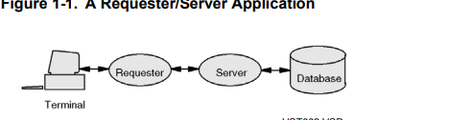
ITS’s Usage :
Permits a user process to receive messages from other user processes, thus sets up the basis of the requester/server model
Permits user processes to receive system messages.
Requester Program accepts data from user and sends data to server process
Server process than process data ( Addition / Updation / deletion of Data from DB ) received and sends reply back to requester
Functional Logics placed at Server , Representation logic placed at requester

Slide 4
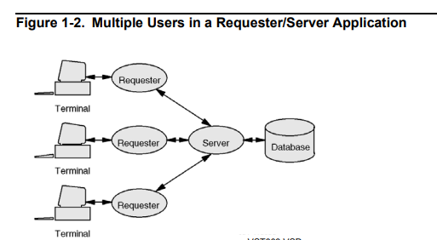
The server process is able to handle requests from several requesters. Typically, the server handles one request at a time; when the server completes a request, it waits for a request from some other requester. Alternatively, the server can be designed to process requests concurrently

Slide 5
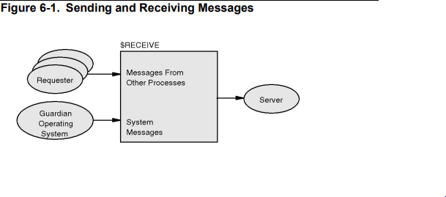
How IPC Works?
A process sends a message to another process by opening the recipient process file ( $RECEIVE ) and writing a message to it.
Each process has its own $RECEIVE input file.

Slide 6
Communication with other process is done using the Guardian Procedure calls .
The HP Non Stop Operating System (OS) includes the Guardian interface and the Open System Services (OSS) subsystem, which provides a UNIX-like interface.
A requester process initiates communication with a server process by sending a message (a request) to the server. To do so, the requester process typically executes the following sequence:
1. Open the server process.
2. Create the request in a buffer in the requester’s user data stack or extended data segment.
3. Send the message to the server, optionally waiting for a reply.

Slide 7
1. Opening the Server Process
File_open_ GPC
The FILE_OPEN_ procedure establishes a communication path between an application process
error := FILE_OPEN_ ( {filename|pathname}:length },filenum );
The following example opens process $SER1 for waited I/O.
FILE^NAME := "$SER1" -> @S^PTR;
LENGTH := @S^PTR '-' @FILE^NAME;
ERROR := FILE_OPEN_(FILE^NAME:LENGTH, FILE^NUM, ! ACCESS!, !Exclusion!, !Nowait! ) ;
IF ERROR <> 0 THEN ...
The FILE_OPEN_ procedure establishes a communication path between an application process and a file. When FILE_OPEN_ successfully completes, it returns A file number to the caller
When Does Open finishes ? Once the server opens the $RECEIVE file ….

Slide 8
Writing Messages to Another Process :
Once file is opened a file number is assigned to it
To send a message, you use either the WRITE[X] or WRITEREAD[X] procedure. For two-way communication (reply data expected), you should use WRITEREAD[X].
For one-way communication (no reply data expected) , you can use a call to WRITE[X]
one-way communication with error return use WRITEREAD[X].

Slide 9
Writing a Message: No Reply Data Expected
The following example writes a message to a process without expecting any reply data. Here, the process has been opened using waited I/O.
SBUFFER ':=' REQUEST.MESSAGE FOR $LEN(REQUEST.MESSAGE);
CALL WRITE[X] (FILE^NUM,
SBUFFER, $LEN(REQUEST.MESSAGE),
COUNT^WRITTEN);
The WRITE[X] procedures write data from an array in the application program to an open file
The WRITE procedure is intended for use with 16-bit addresses, while WRITEX is intended for use with 32-bit extended addresses.
The WRITE[X] procedure returns when the recipient process has read the message by issuing a READ[X] procedure call or has called REPLY[X] to respond to the message after having read it with READUPDATE[X];

Slide 10
If you opened the process using nowait I/O, then the WRITE[X] procedure returns immediately.
The requester and server become synchronized when the requester completes the corresponding call to AWAITIO[X]. The following example shows how this part of the requester might be coded:
LENGTH := $LEN(REQUEST.MESSAGE);
SBUFFER ':=' REQUEST.MESSAGE FOR LENGTH;
CALL WRITEX ( PROC^NUM, SBUFFER, LENGTH, COUNT^WRITTEN);
IF <> THEN ...
CALL AWAITIOX(PROC^NUM );
IF <> THEN ...

Slide 11
Writing a Message: Reply Data Expected
Two-way communication expects reply data in reply to a written message. Here, you use the WRITEREAD[X] procedure to send the message to the server and receive the reply from the server in the same buffer
This example assumes waited I/O.
STRUCT .RECORD;
BEGIN
INT FUNCTION^CODE;
INT ACCOUNT^NUMBER;
INT AMOUNT;
END;
RECORD.FUNCTION^CODE := ADD;
RECORD.AMOUNT := 250;
RECORD.ACCOUNT^NUMBER := 16735;
WCOUNT := $LEN(RECORD);
RCOUNT := $LEN(RECORD);
CALL WRITEREADX(PROC^NUM, RECORD, WCOUNT, RCOUNT, COUNT^READ);
IF <> THEN ...

Slide 12
On Server first open $RECEIVE to read the message being sent by the requester
FILE^NAME ':=' "$RECEIVE";
LENGTH := 8;
RECV^DEPTH := 1;
ERROR := FILE_OPEN_( FILE^NAME:LENGTH, RECV^NUM, !access!, !exclusion!, !nowait^depth!, RECV^DEPTH );
IF ERROR <> 0 THEN ...
Use the READUPDATE[X] procedure to read a message from $RECEIVE if you want to reply to the message with data.
CALL READUPDATE[X] ( RECV^NUM, SBUFFER, RCOUNT );
IF <> THEN ...

Slide 13
After reading a message from $RECEIVE using the READUPDATEX procedure, use the REPLYX procedure to send the reply.
STRUCT .RECORD;
BEGIN
INT FUNCTION^CODE;
INT ACCOUNT^NUMBER;
INT AMOUNT;
END;
RECORD.AMOUNT := 1250;
WCOUNT := $LEN(RECORD);
ERROR := 0;
CALL REPLYX( RECORD, WCOUNT, !count^written!, !message^tag!, ERROR);
IF <> THEN ...

Slide 14
Closing $RECEIVE You explicitly close $RECEIVE as you would any file using the FILE_CLOSE_ procedure:
ERROR := FILE_CLOSE_(RECV^NUM);
IF ERROR <> 0 THEN ...
As for any file, if you do not explicitly close $RECEIVE, then the file is implicitly closed when the process terminates.

Slide 15
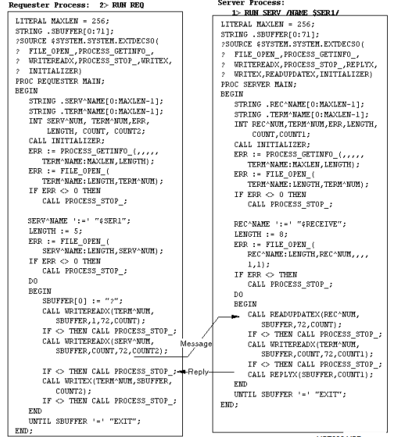

Slide 16
Assignments
Accept Your Name from terminal and print “HELLO” followed by your Name back on Terminal
Accept 2 Numbers from Terminals, and perform addition/ substraction, multiplication / Division based on user selected operation.
Create any enscribe file, and write a requester / server program where the data can be added, removed or updated from enscribe file.

Slide 17
Notes
Make use of Comments…. ( ! / -- )
Initialize Variables ….
Flush buffer if you want to reuse ( not being passed by reference )...
Ensure Structures are of even bytes…
Avoid using hardcoded values ….
Follow Indentention as below ( 4 Spaces before begin/ end keyword ) …
If abc.a = abc.b then
begin
……..
end

Slide 18
THANK YOU !! HAVE A NICE DAY!!

